Slide 2
COMPANY PROFILE
Our Mission
Our Vision
Deliver the world’s most effective and sustainable solutions for safe and secure product handling
Our Goals
To create value for our customers through Reliability and Flexibility
Enhance the structure and functioning of the furniture industry

Slide 3
CORE PEOPLE
Daizy Jain
Founder
51%
Sukmal Kumar Jain
Managing Partner
49%

Slide 4
TEAM MEMBERS
1.Sonal Srivastava: Working as a manager, holds a good experience in the field of marketing and designing, and helps in guiding the team and creating a good environment.
2. Anandita Rawat: Working as an Accounts Manager holds a good knowledge in accounting and audit field and is responsible for maintaining our Books of Accounts.
3. Sachin Bhasin: Working as a store in charge and is responsible stock validation and keeps a good track of inward and outward stock.
4. Mahak Bhatia: Working in Operations i.e. managing all the backend work.

Slide 5
UPCYCLING OF FURNITURE
The main focus of the Organization is to make full use of scrap furniture by collecting them from scrap dealers and convert un-usable furniture into usable modern, aesthetic and good-looking furniture.
Benefits of Up cycling
The environmental benefits of up cycling are mammoth, aside from minimizing the volume of discarded materials and waste being sent to landfill each year, it also reduces the need for production using new or raw materials which means a reduction in air pollution, water pollution, greenhouse gas emissions and often a conservation of global resources.

Slide 6
Benefits of Up cycling
Environmental benefits of Up cycling | Social and Economic Benefits of Up cycling | Personal benefits of Up cycling
1. Saving materials from landfill These days, many brands and designers are making very cool stuff from old stuff. Plenty of items that were once en route to landfill have been reclaimed by some very creative people. | 1. Celebrating artisanal work and old school craftsmanship Behind every up cycled product, there is a maker who strongly believes in a level of craftsmanship that we just don’t see very much anymore. | 1. Doing your bit for Mother Nature Nothing beats that warm and fuzzy feeling you get inside when you’ve done something great for the planet.
2. Reducing what goes into landfill We’ve become so used to things being mass manufactured and made in a heartbeat that we buy things as quickly as we throw things away. | 2. Supporting local and rural industry Another social and economic benefit of up cycling is that it supports small local businesses as well as rural village industries. | 2. Crafty repair skills Repairing an item and giving it a new life is a great skill and a wonderful feeling.
3. Minimal use of natural resources Up cycling existing resources means that we don’t have to use any new raw materials in the production process. | 3. Reduced manufacturing costs If designers make items from reclaimed materials, this can drastically reduce their manufacturing costs. | 3. One-of-a-kind items Whether you’re up cycling things yourself or buying products from designers, it’s always nice to know that you have something that is completely unique.

Slide 7
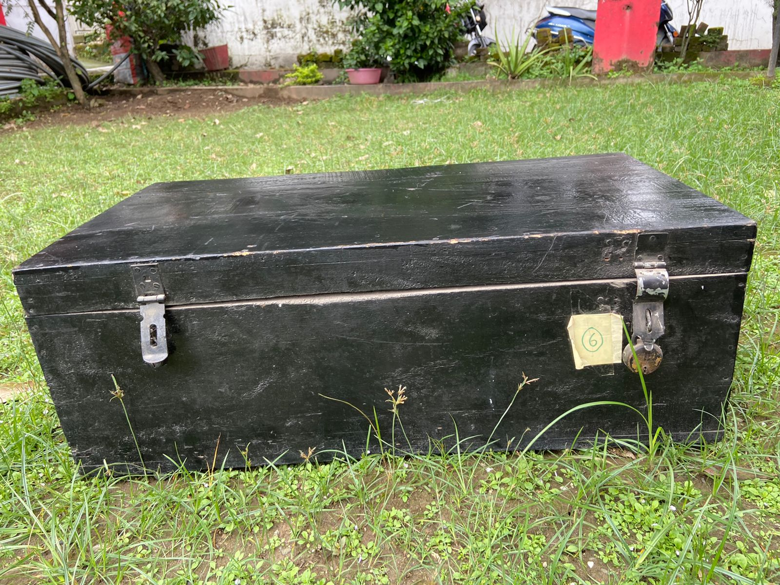
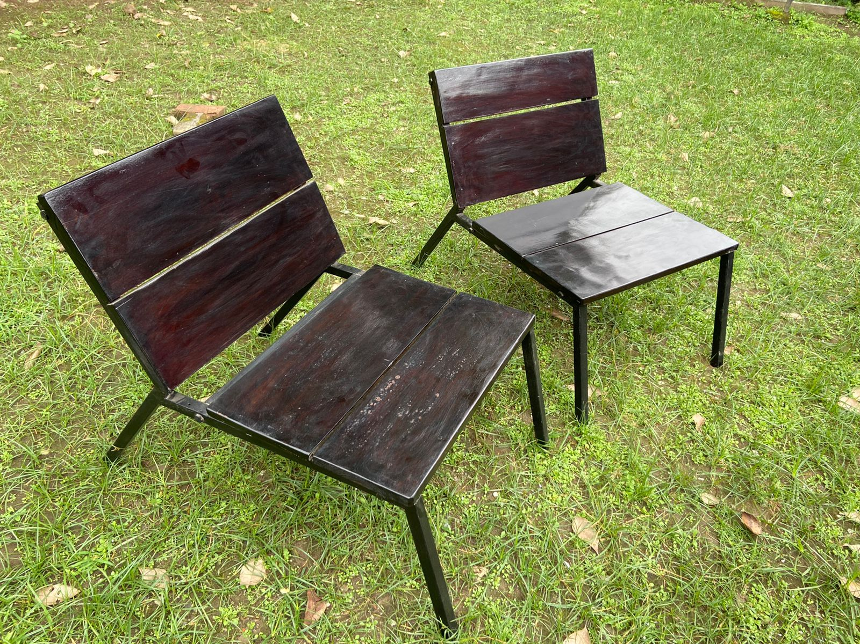
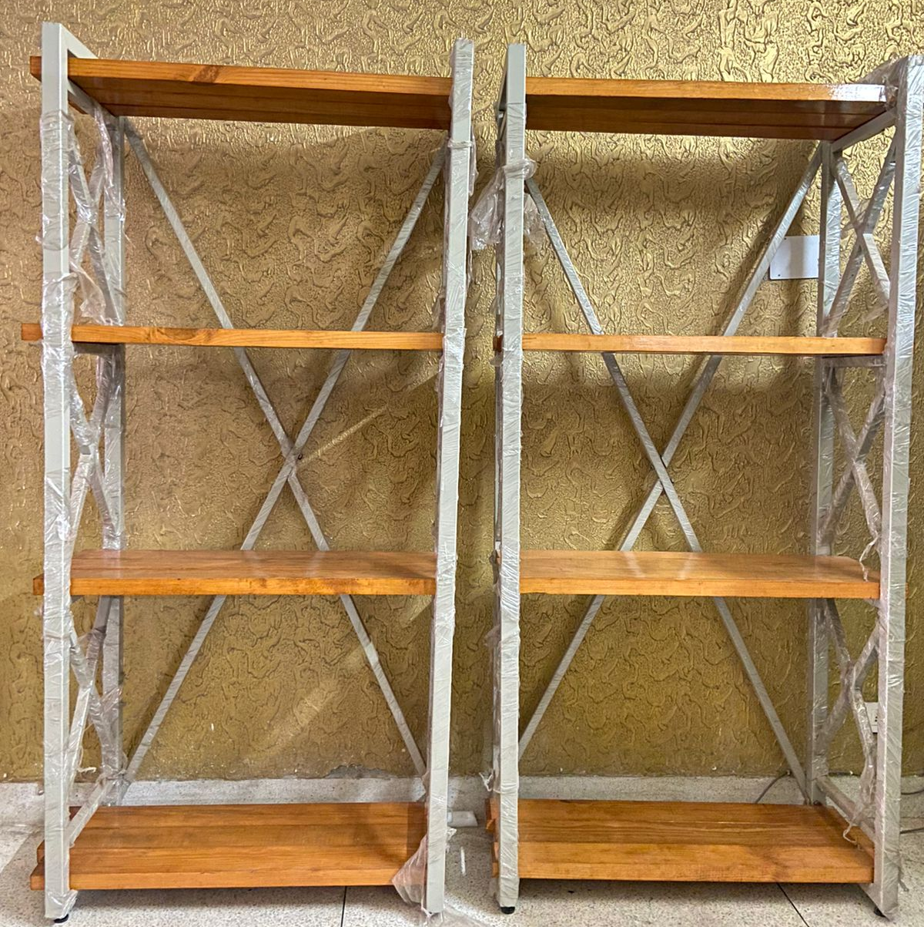
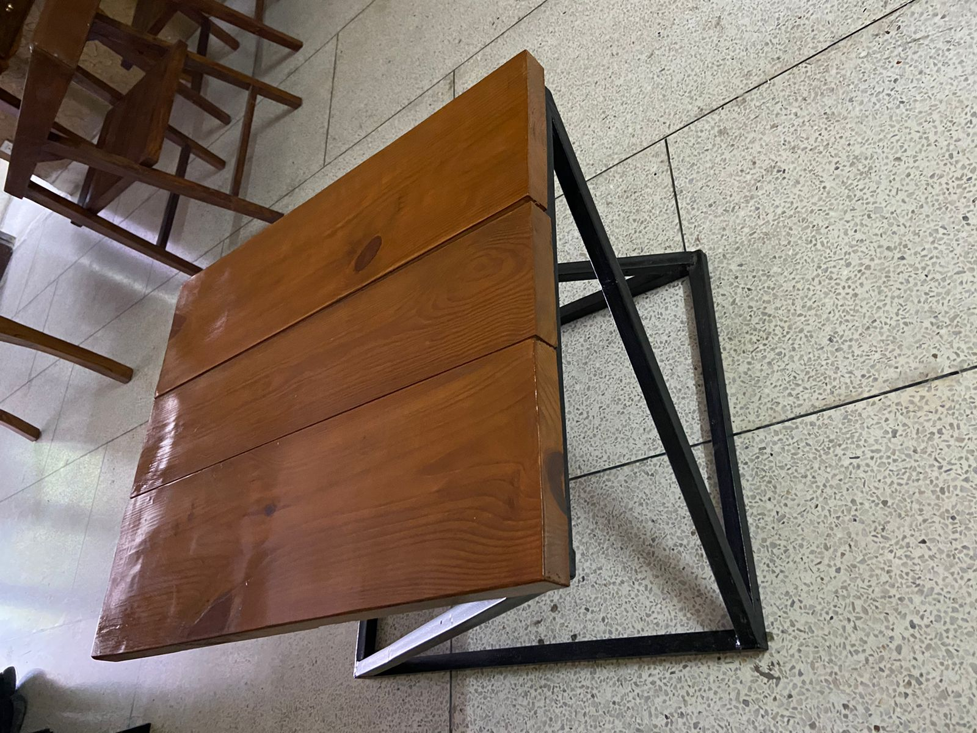
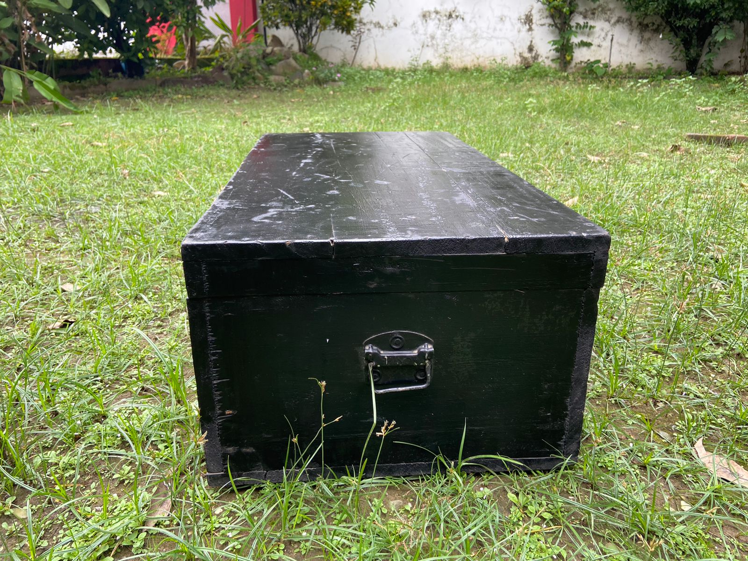
FEW UP SCALING WORKS DONE BY US

Slide 8
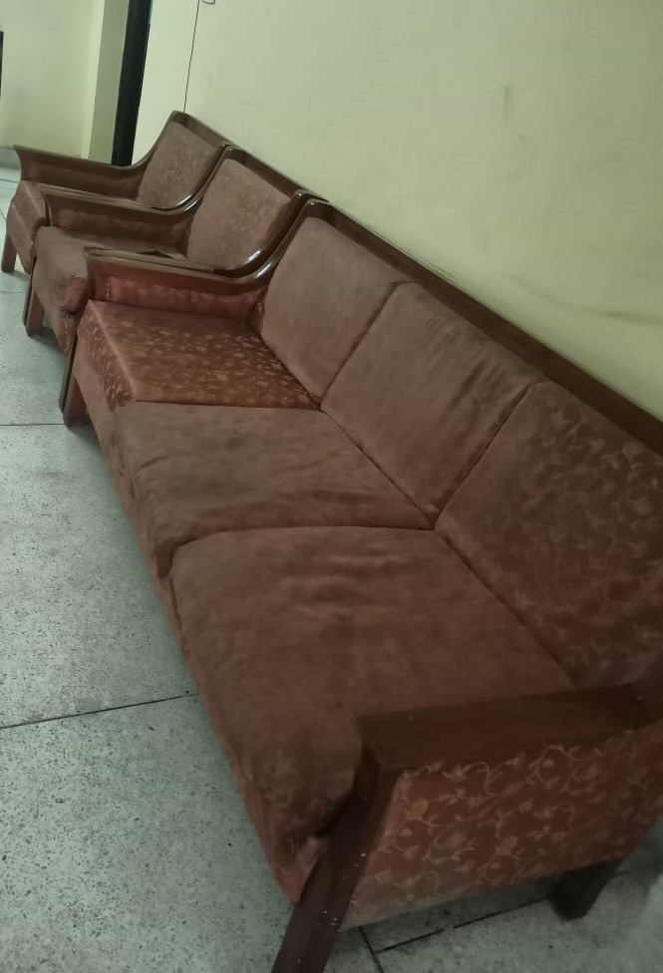
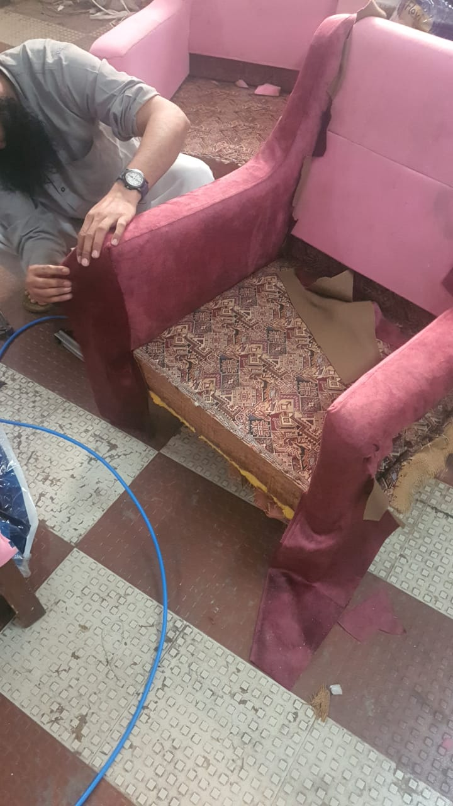
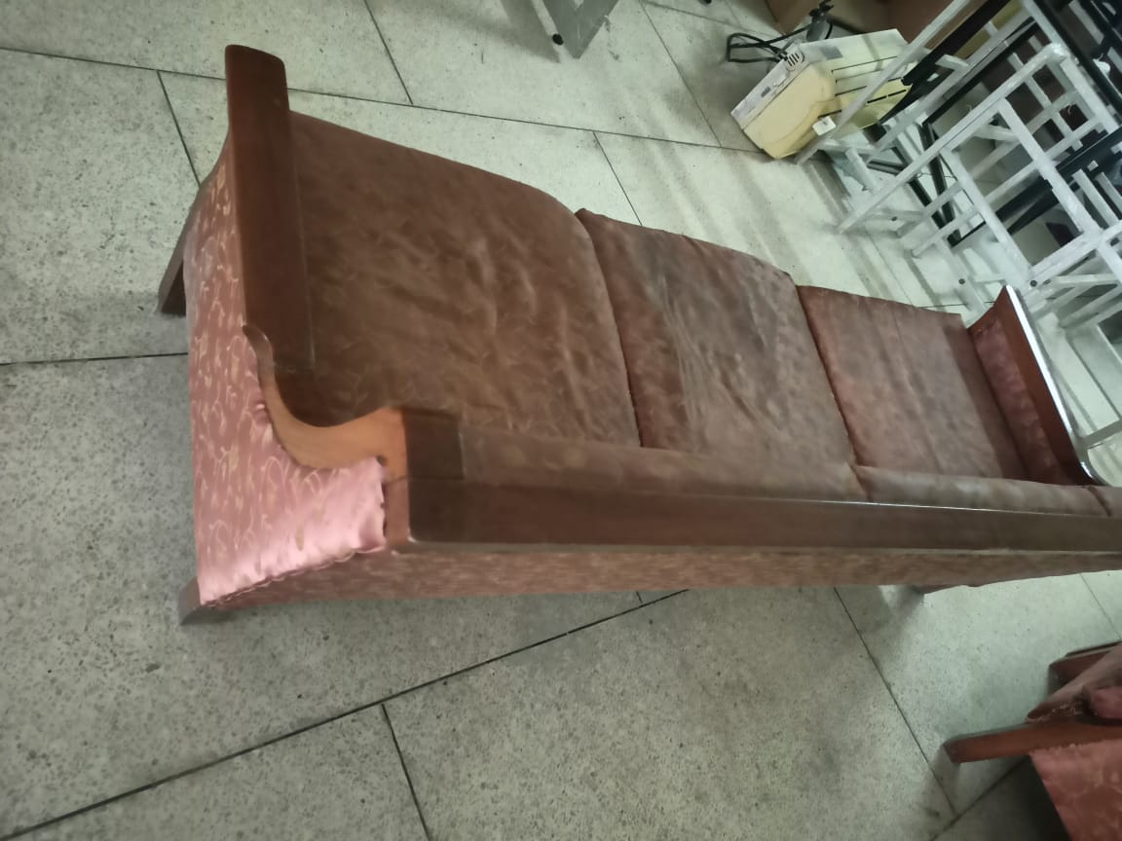
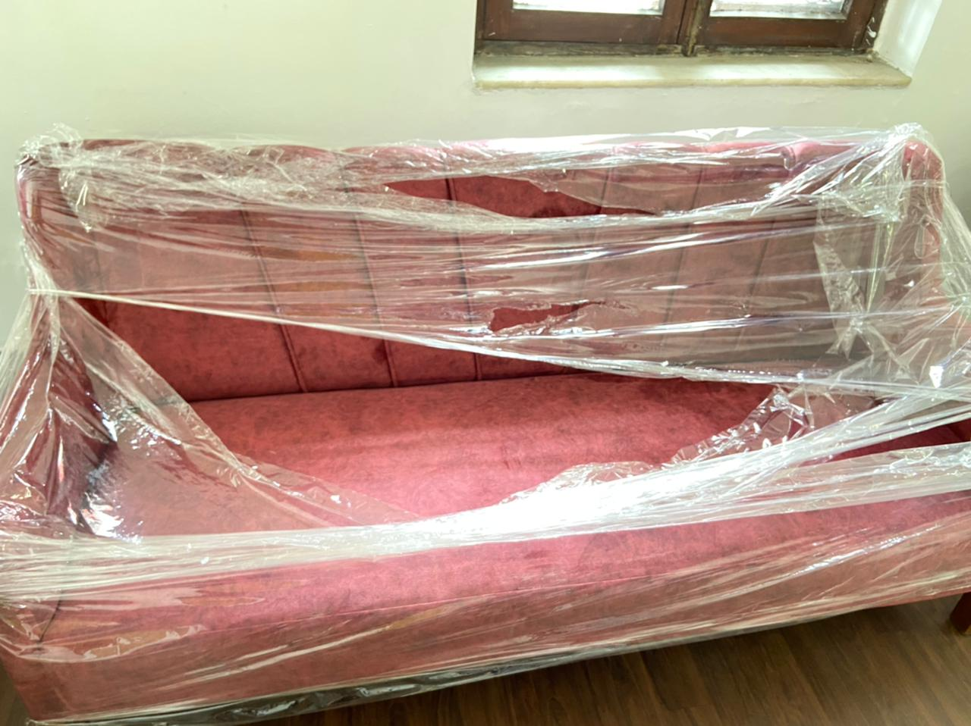
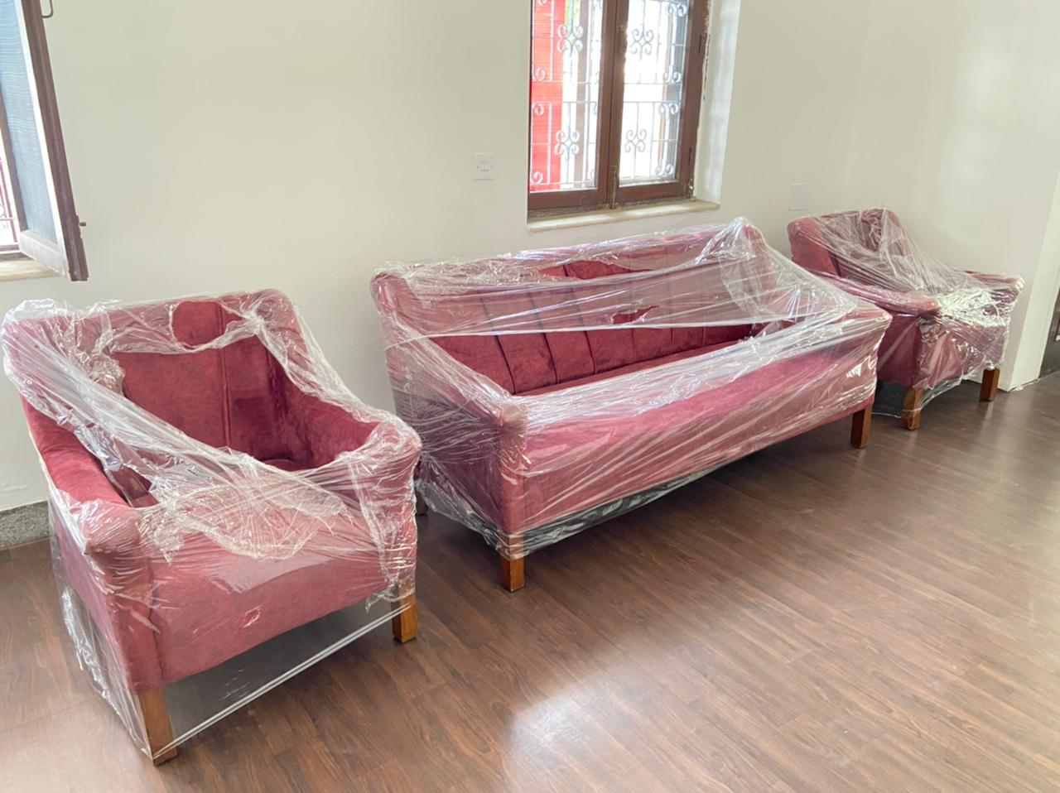
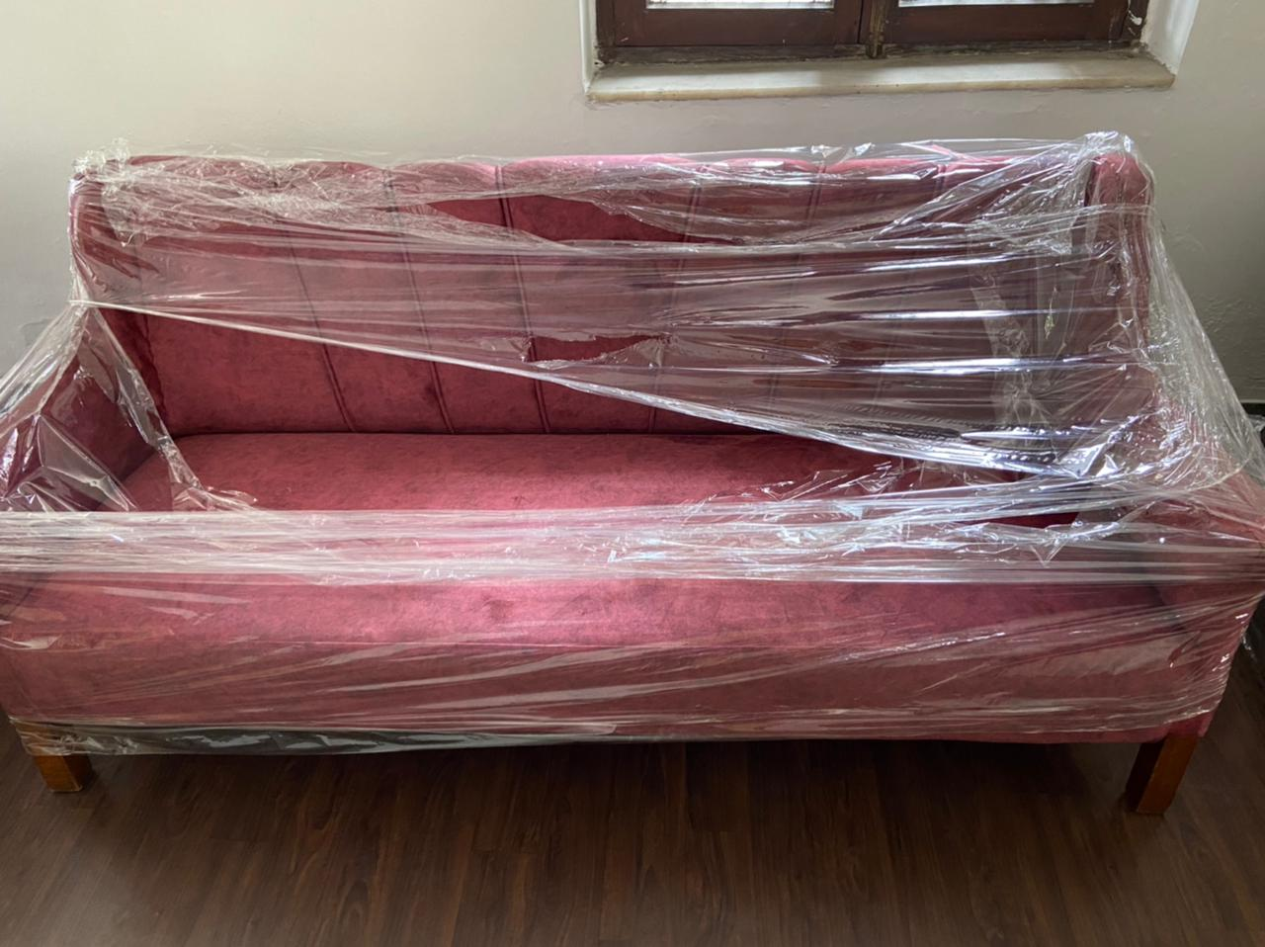

Slide 9
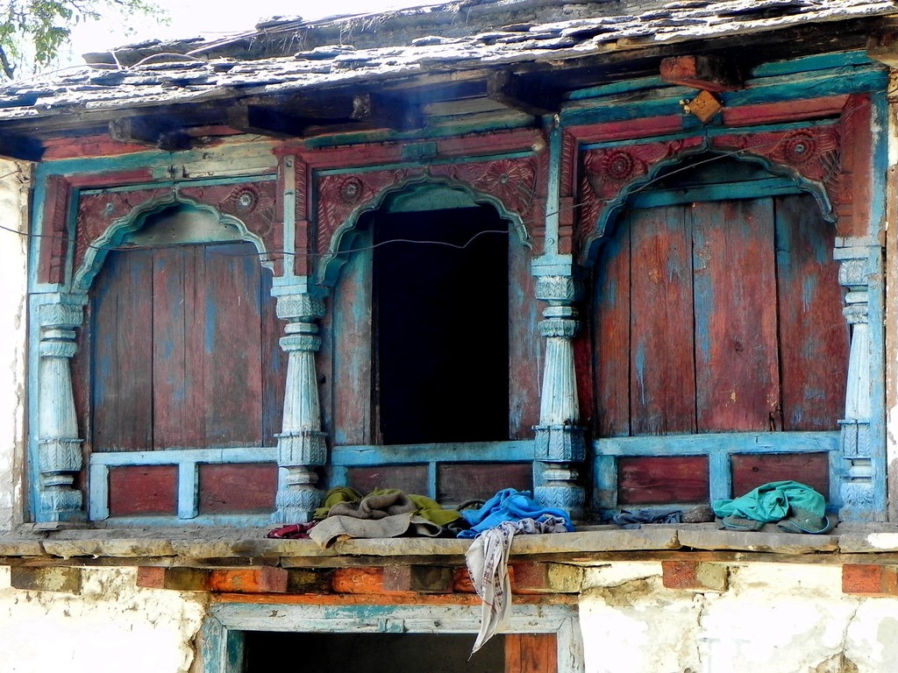
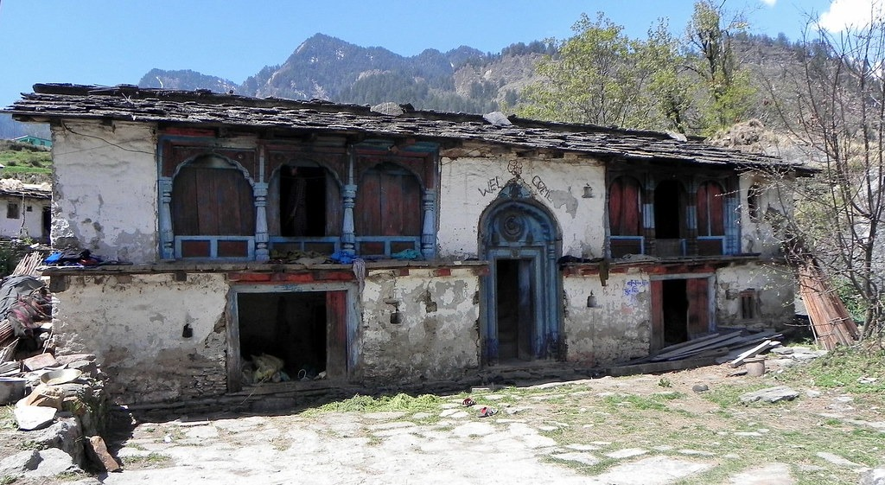
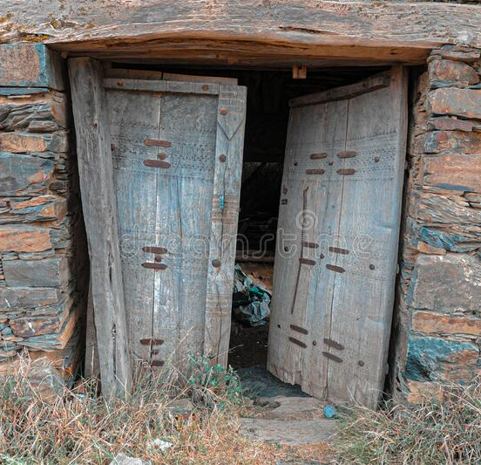
Need To Re-store Our Heritage
We are planning to upscale these abundant tibari’s , doors and other wooden material into new artifacts , antiques and also can be used as home decors. The idea behind this is to save or preserve the Uttarakhand’s heritage.

Slide 10
Key Activities
To create world class furniture and deliver customised wood work
ISHAANYA VENTURES
Geographical Location (Area of Operation)
Serve in entire districts of Uttarakhand

Slide 11
Established in 2021 Our customers
Higher Education Departments Uttarakhand
National Highways Authority of India
Executive Engineer, RWD
Chief Education Office

Slide 12
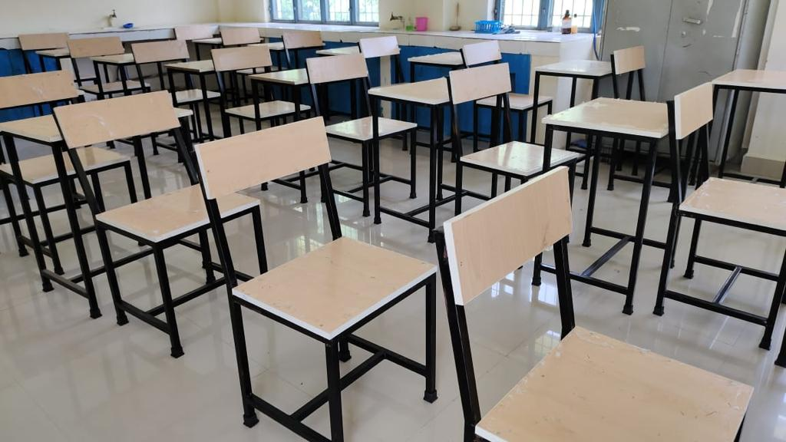
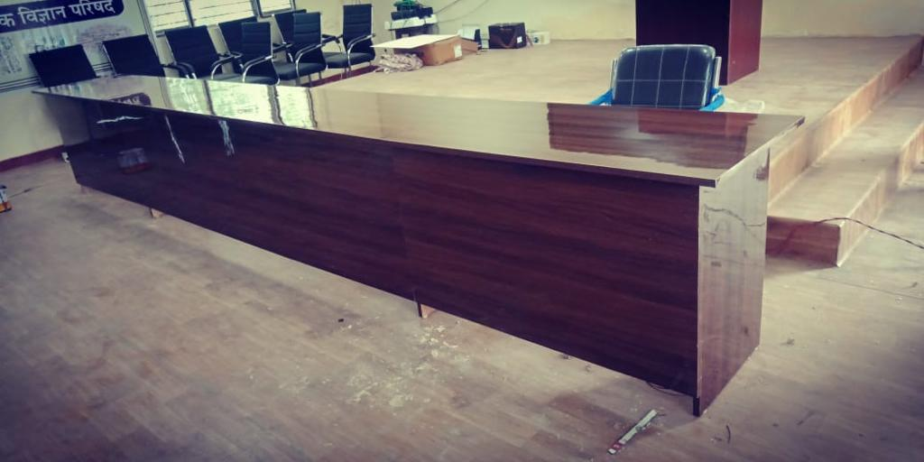
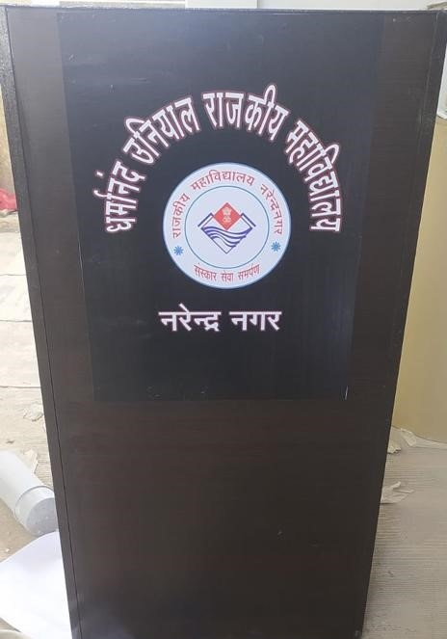
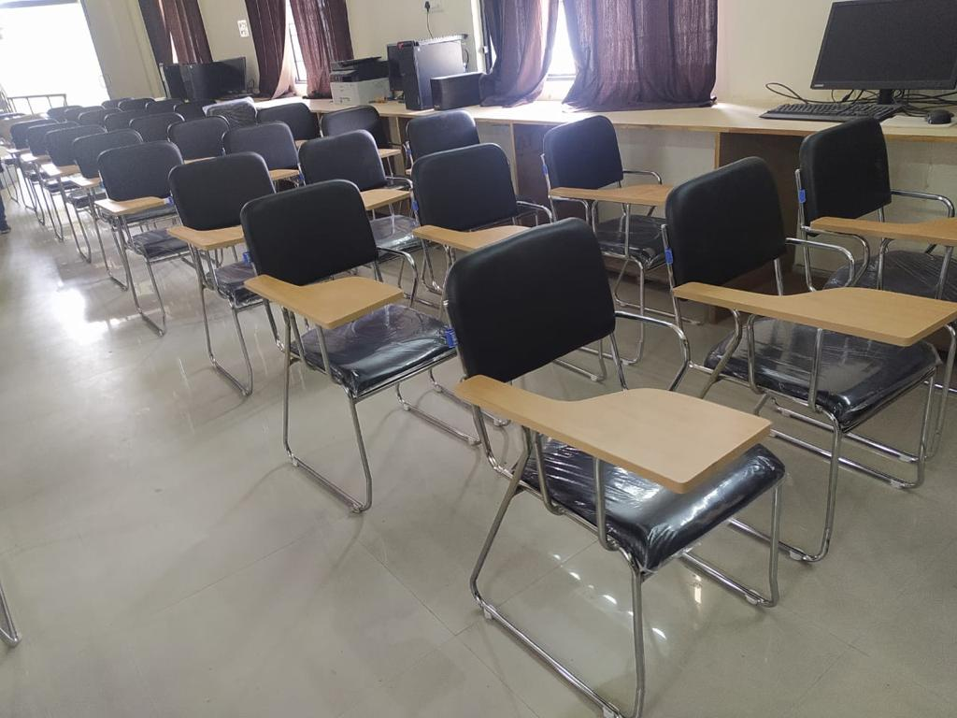
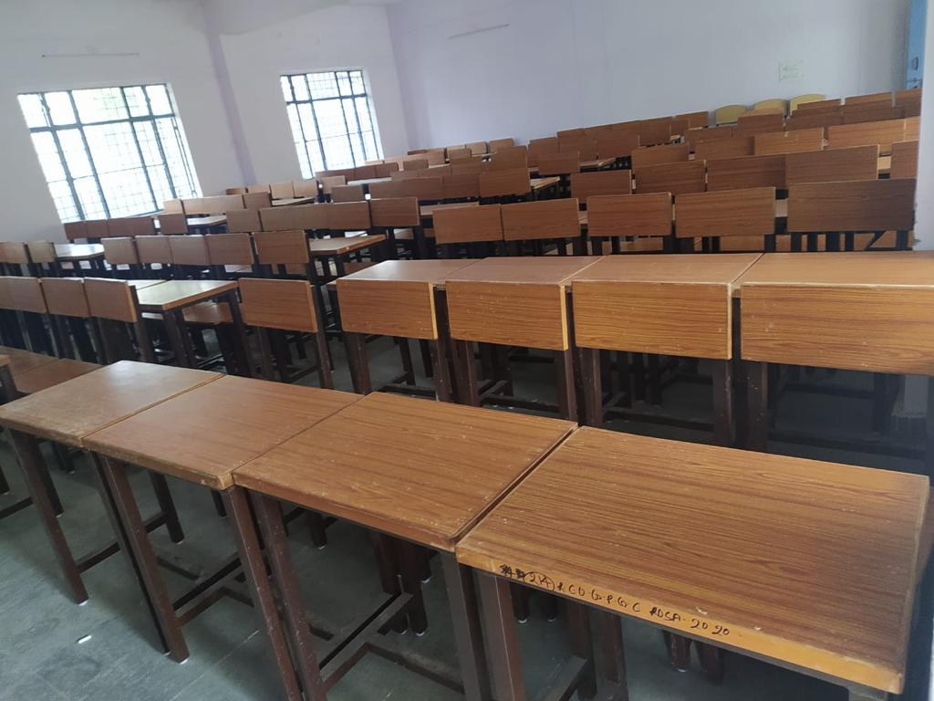
FEW PROJECTS DONE BY US

Slide 13
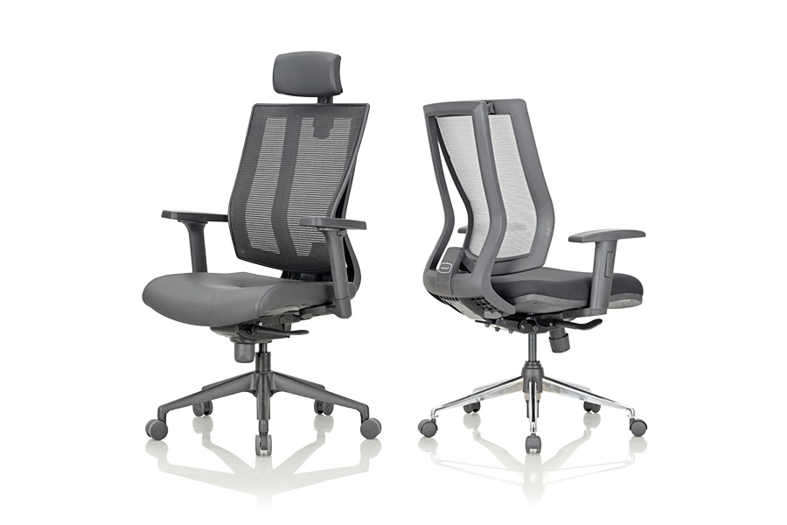
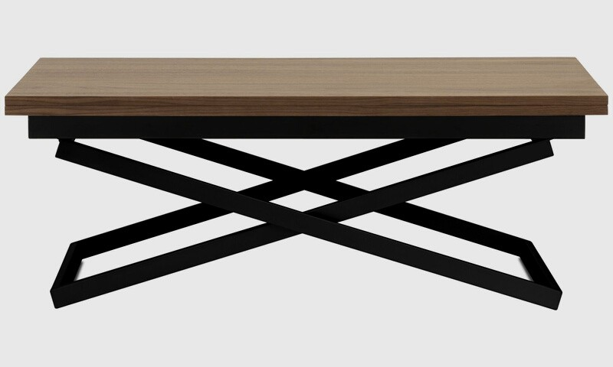
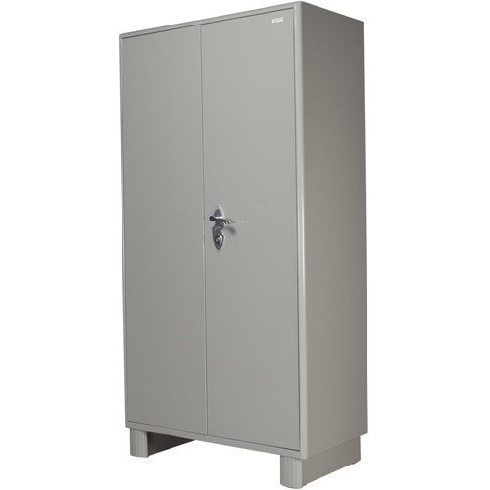
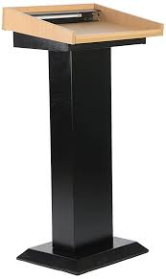
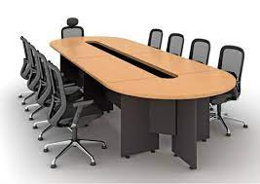
REVOLVING CHAIRS
OUR PRODUCTS
TABLES
ALMIRAHS
PODIUMS
CONFERENCE TABLES

Slide 14
Marketing Strategies And Technology Used
As ecommerce marketing is a process of promoting your online store and products through a variety of marketing channels.
We are also currently registered with gem for government related transactions.
We are also creating a technology platform in form of marketplace where the sellers who want to liquidate their old furniture to us they can sell to us and will have option to get credits from which they can buy any upscale products or will have upfront payment option. Also, the portal is still under development.
We are also Planning to integrate our portal with D2C platform like Amazon, Flipkart and B2B Platform like Indiamart and Trade India

Slide 15
THANK YOU
We look forward to work with you
295 Phase II, Vasant Vihar, Dehradun
9359909955

